Slide 1
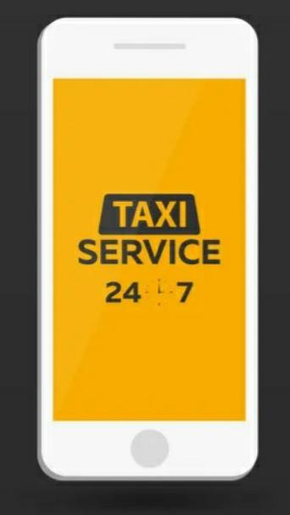

ANALYSIS OF

Slide 2
USER INTERFACE

Slide 3
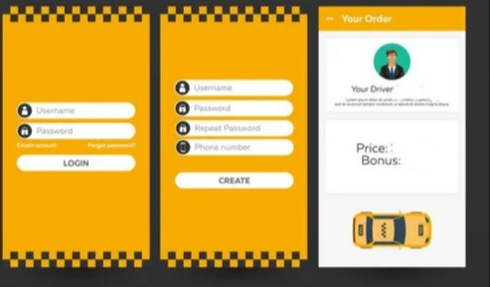

Slide 4
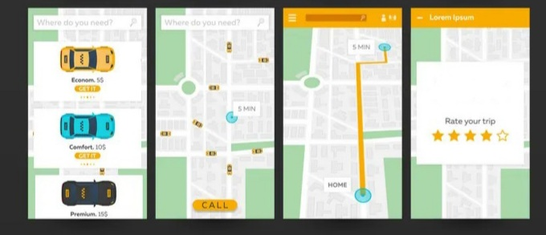

Slide 5
USE CASE DIAGRAM

Slide 6
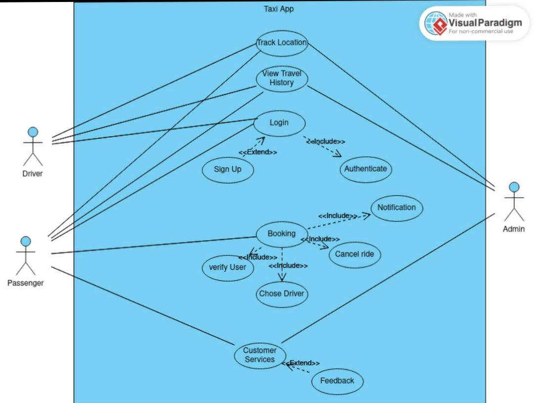

Slide 7
ACTIVITY DIAGRAM

Slide 8
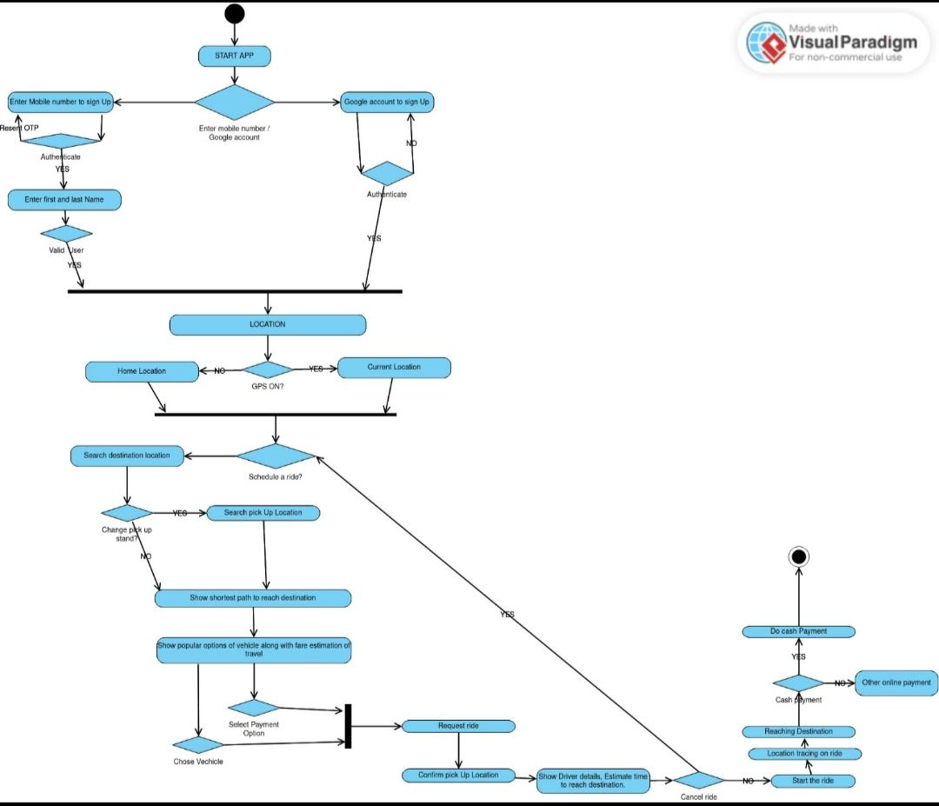

Slide 9
SEQUENCE DIAGRAM

Slide 10
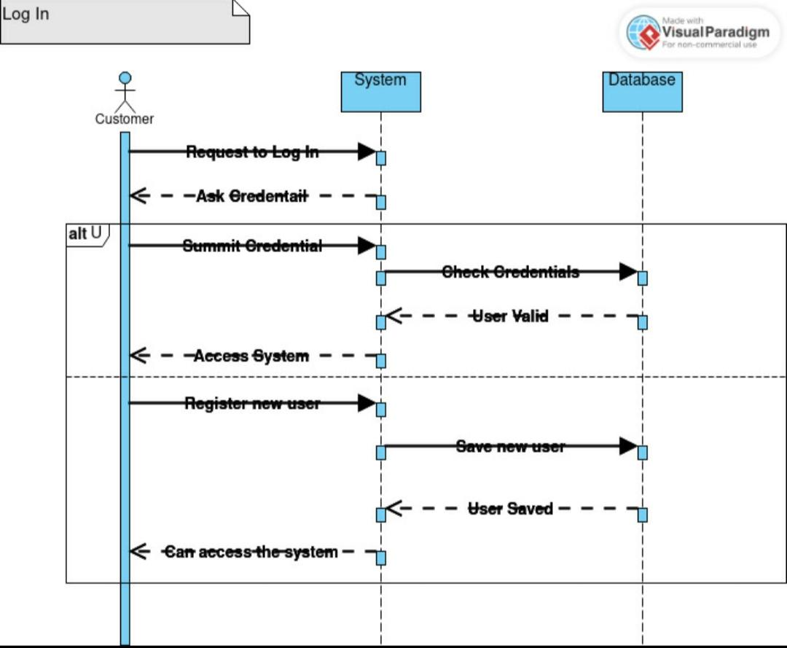
Sequence diagram of Log In Use Case

Slide 11
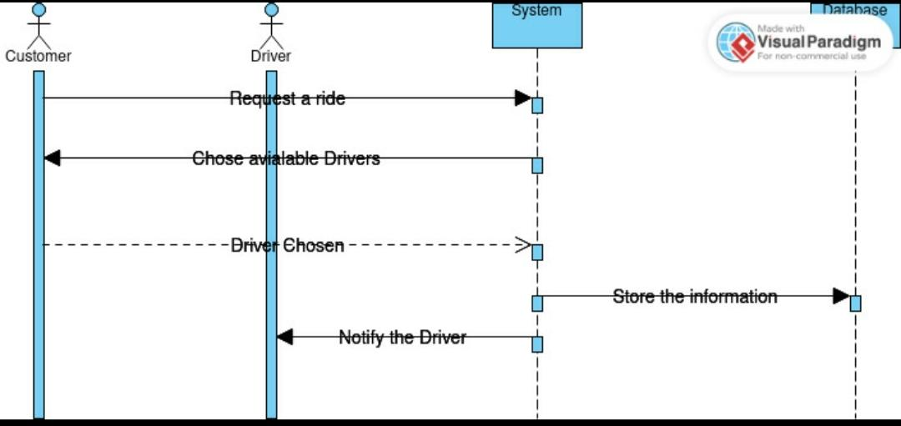
Sequence diagram of Booking Use case

Slide 12
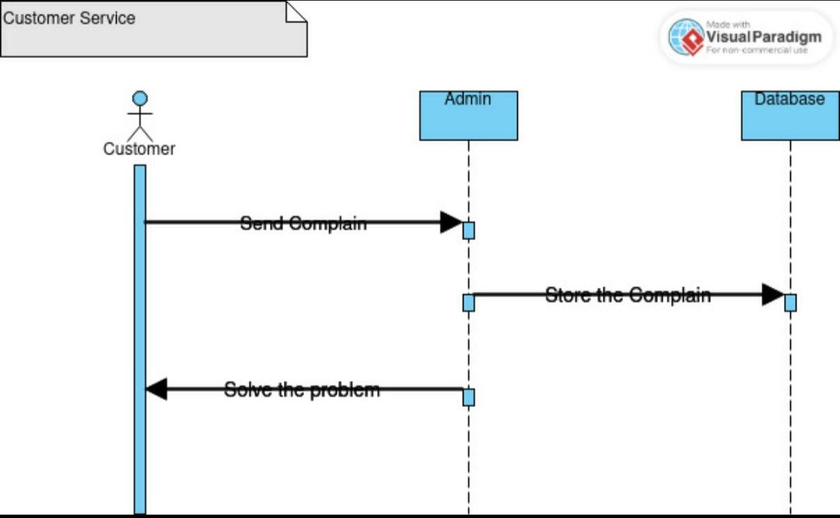
Sequence diagram of Customer service Use Case

Slide 13
DATA FLOW DIAGRAM

Slide 14
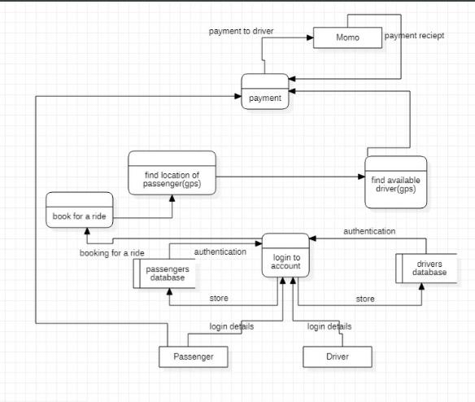

Slide 15
CLASS DIAGRAM

Slide 16
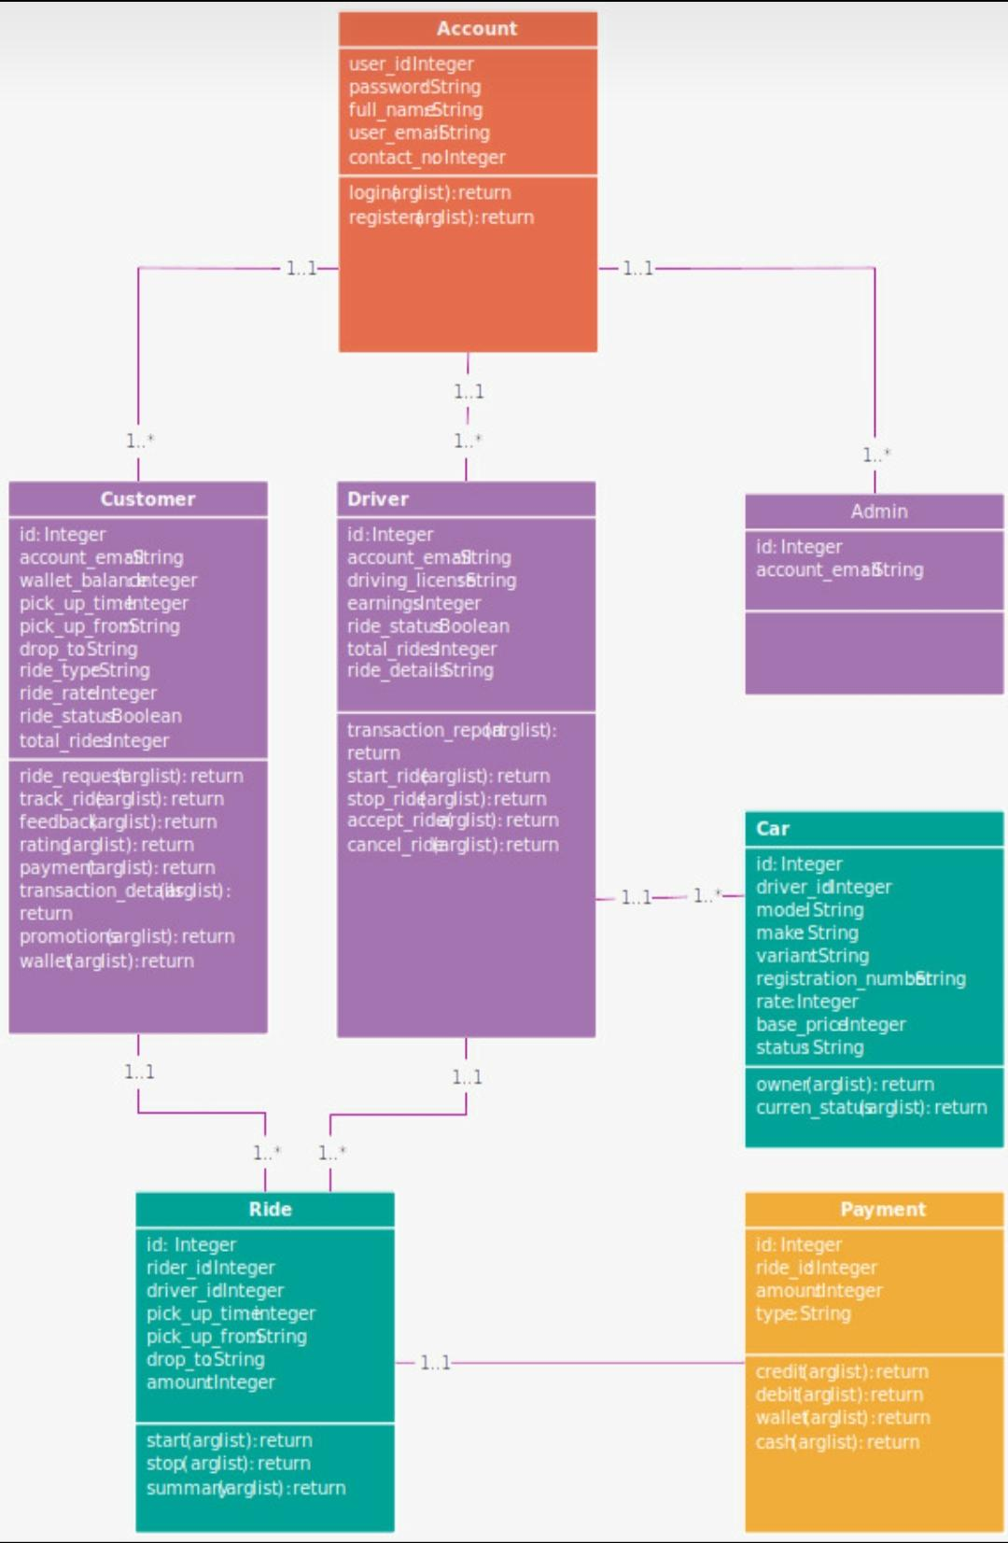

Slide 17


